Slide 1


High performance computing and additive manufacturing summer camp
Sandra Gesing, Anuj Tiwari (DPI)
Jifu Tan, Ryan Mueller (NIU)
sgesing@uillinois.edu

Slide 2
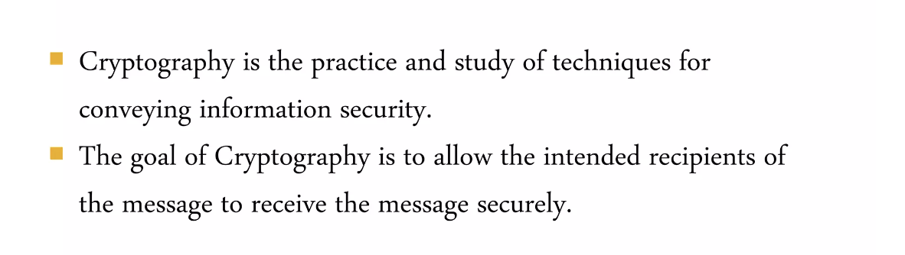
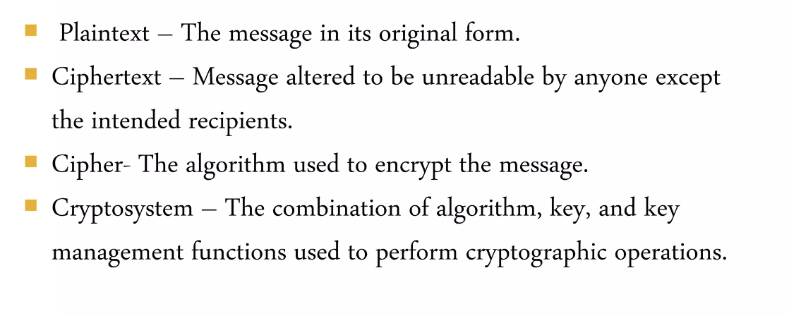
Security and Cryptography

Slide 3
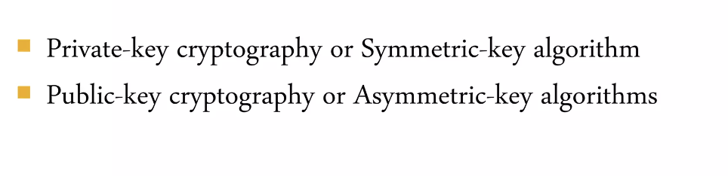
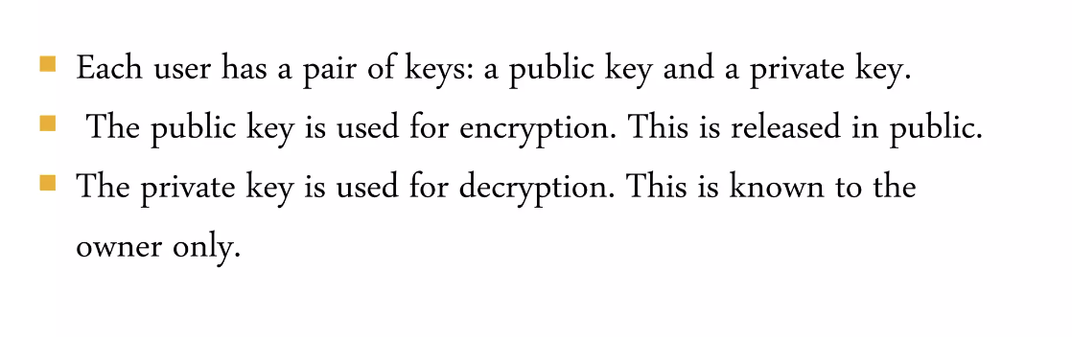
Security and Cryptography

Slide 4
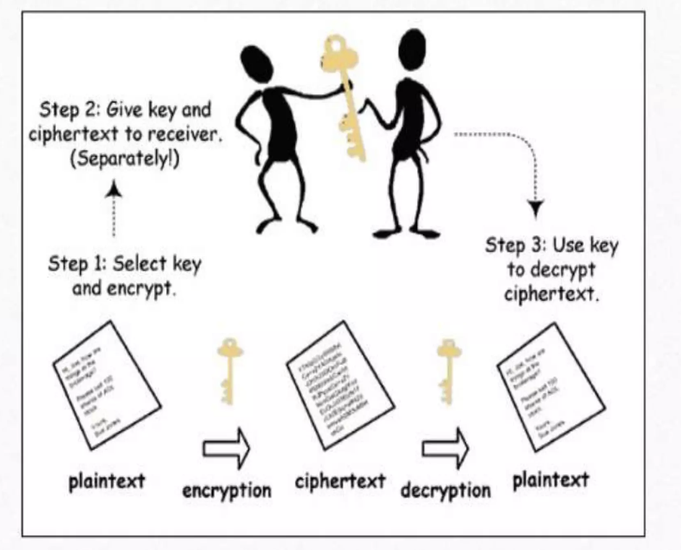
Security and Cryptography

Slide 5
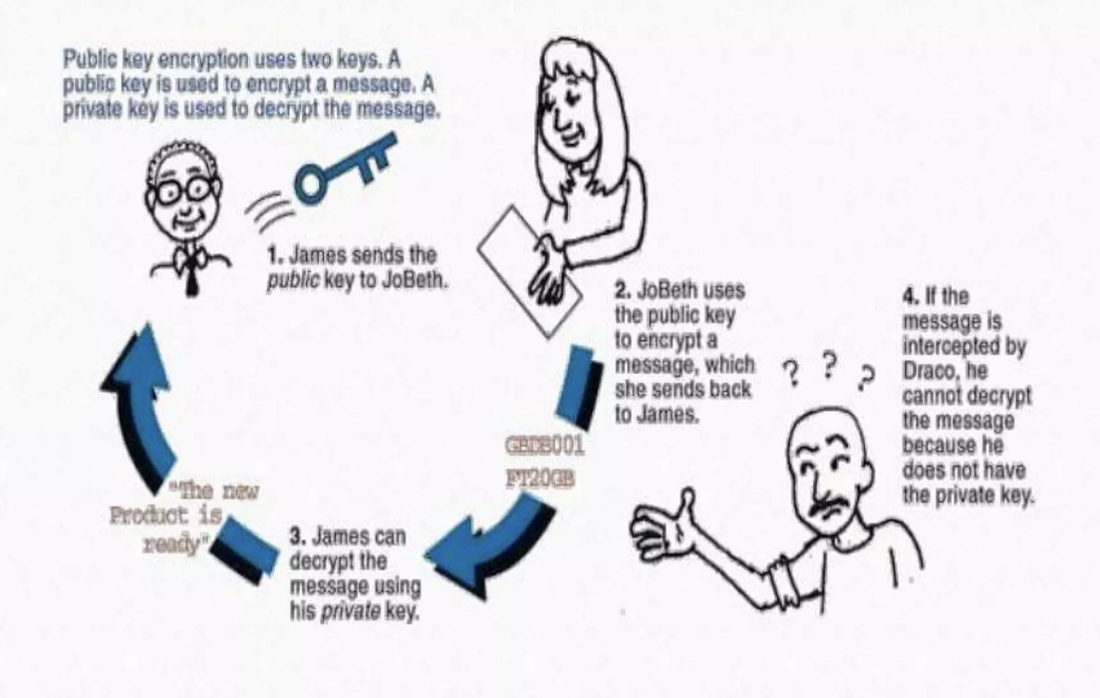
Security and Cryptography

Slide 6
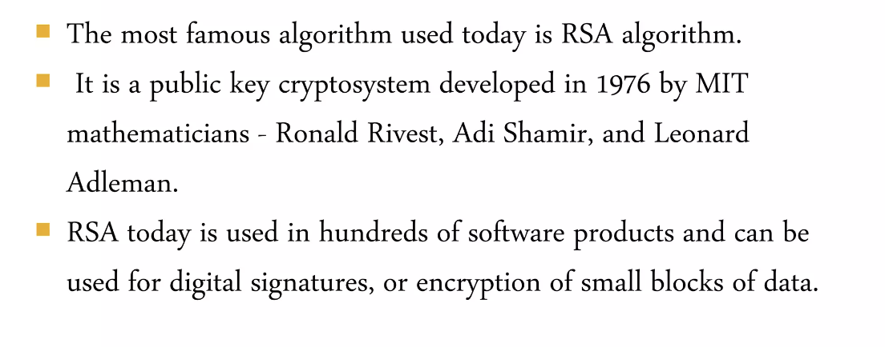
Security and Cryptography

Slide 7
RSA
According to the National Institute of Standards and Technology recommendations, RSA encryption with 2048-bit encryption keys is safe to use until the end of 2030. While you can always choose the 4096-bit key length that would stay relevant a bit longer, longer keys are not sustainable. Dec 31, 2022
Most ransomware uses RSA with a 2048-bit key. However, the most robust and most uncrackable version of RSA uses a 4096-bit key. It is probable that now they can crack 1024-bit, Chinese government technicians are busy working out a way to crack the next step up, which is the 2048-bit key.

Slide 8
High-Performance Computing
Why Use Parallel Computing?
• Single processor speeds are reaching their ultimate limits
• Multi-core processors and multiple processors are the most
promising paths to performance improvements
Definition of a parallel computer:
A set of independent processors that can work cooperatively
to solve a problem.

Slide 9
Performance
The March towards Petascale Computing
• Computing performance is defined in terms of
FLoating-point OPerations per Second (FLOPS)
1 GF = 109 FLOPS
1 TF = 1012 FLOPS
1 PF = 1015 FLOPS
GigaFLOP
TeraFLOP
PetaFLOP
• Petascale computing also refers to extremely large data sets
PetaByte 1 PB = 1015 Bytes

Slide 10
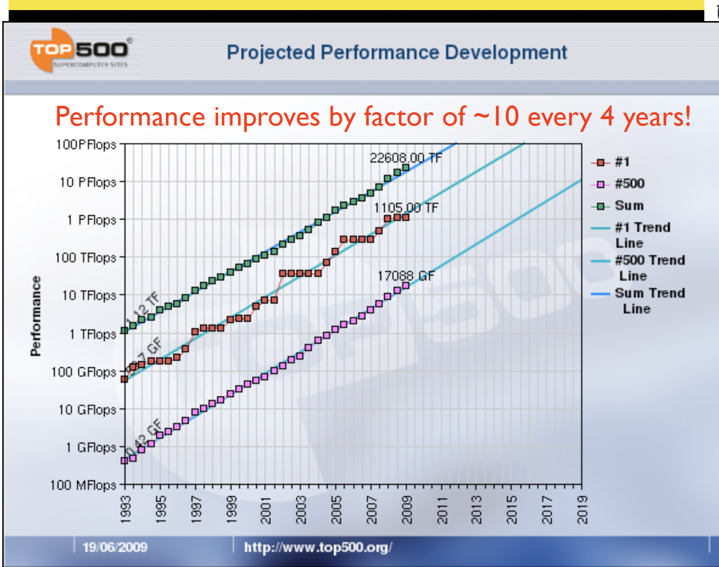
Performance

Slide 11
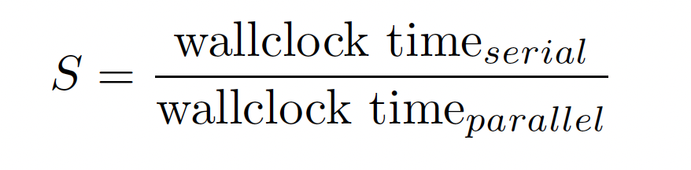
Thinking in Parallel
DEFINITION Scalability: The ability of a parallel algorithm to
demonstrate a speedup proportional to the number of processors
used.
DEFINITION Speedup: The ratio of the serial wallclock time to the
parallel wallclock time required for execution.
An algorithm that has good scalability will take half the time with
double the number of processors
Parallel Overhead, the time required to coordinate parallel tasks
and communicate information between processors, degrades
scalability.

Slide 12
Thinking in Parallel
• Each scientific or mathematical problem will, in general, require a unique strategy for efficient parallelization
Thus, each of you may require a different parallel implementation
of your numerical problem to achieve good performance.
• Flexibility in the way a problem is solved is beneficial to finding a parallel algorithm that yields a good parallel scaling.
• Often, one has to employ substantial creativity in the way a
parallel algorithm is implemented to achieve good scalability.

Slide 13
Rule of Thumb
Computation is FAST
Communication is SLOW
Input/Output (I/O) is INCREDIBLY SLOW

Slide 14
Clusters: Connected Array of Computers
Four types of clusters:
High Availability (HA) – Used for Fault Tolerance to keep server services available to employees or customers
Load Balancing – balances the load between multiple systems when a service needs to be available to numerous systems at once (can be used for other three types of Clusters)
Distributed – jobs will be managed by different systems
Parallel – jobs are managed by multiple processors on multiple systems
NOTE: The Distributed and Parallel Clusters are referred to as High Performance (HP) Clusters.

Slide 15
Linux
Linux – a major operating system in HPC
Let’s dive into it!

